Slide 1
Gendered Pronoun Resolution
Gong Qiong
2019.05.22

Slide 2
Outline
Problem
Gender Bias
Dataset
BERT
Evaluation

Slide 3
Outline
Problem
Gender Bias
Dataset
BERT
Evaluation

Slide 4
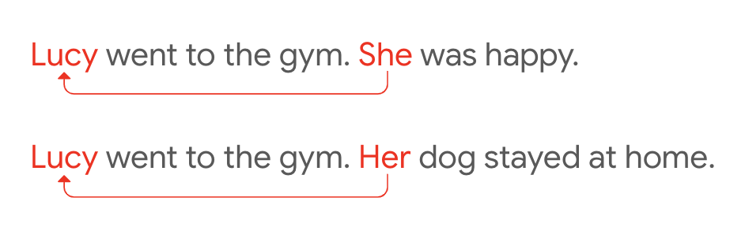
Problem
Coreference Resolution
Coreference Resolution is the task of identifying clusters of mentions referring to the same real-world entity
Pronoun Resolution
task of identifying for a specified pronoun in a passage, which named entity antecedent it refers to.

Slide 5
Problem
Example of Gendered Pronoun Resolution
Kathleen Nott was born in Camberwell, London. Her father, Philip, was a lithographic printer, and her mother, Ellen, ran a boarding house in Brixton; Kathleen was their third daughter. She was educated at Mary Datchelor Girls’ School (now closed), London, before attending King’s College, London.
Target pronoun: She,Candidate A: Ellen, Candidate B: Kathleen
Ground Truth Class (one of A, B or NEITHER): Kathleen

Slide 6
Outline
Problem
Gender Bias
Dataset
BERT
Evaluation

Slide 7
Gender Bias
Recent studies have suggested gender bias among state-of-the-art coreference resolvers.
Only 25%-30% examples are female pronouns
lead to misrepresentation in downstream applications

Slide 8
Outline
Problem
Gender Bias
Dataset
BERT
Evaluation

Slide 9
Dataset
Gendered Ambiguous Pronouns (GAP) dataset
Aims to improve gender-fairness
Gender balanced pronouns
50% of its examples containing feminine pronouns
and 50% containing masculine pronouns

Slide 10
Dataset
8,908 coreference-labeled pairs of (ambiguous pronoun, antecedent name)
4000 for training
4000 for testing
908 for validation

Slide 11
Outline
Problem
Gender Bias
Dataset
BERT
Evaluation

Slide 12
Bert
Bidirectional Encoder Representations from Transformers
BERT’s key technical innovation is applying the bidirectional training of Transformer, a popular attention model, to language modelling.

Slide 13
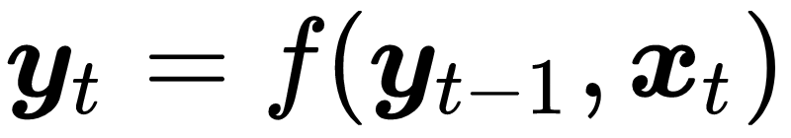
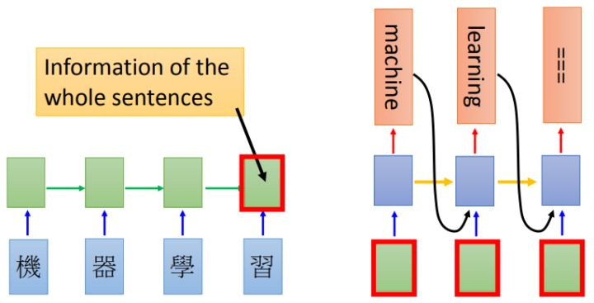
Bert-Attention
RNN
http://speech.ee.ntu.edu.tw/~tlkagk/courses/MLDS_2015_2/Lecture/Attain%20(v3).pdf

Slide 14
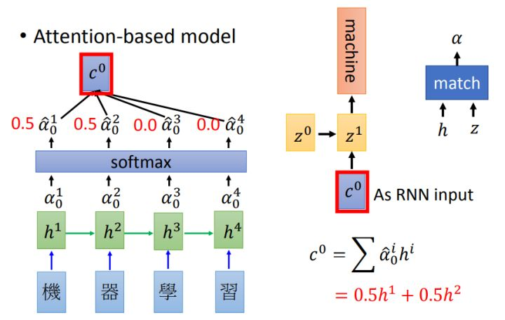
Bert-Attention

Slide 15
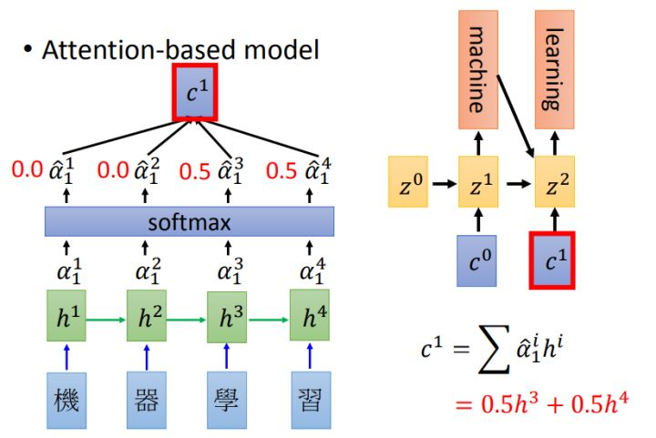
Bert-Attention

Slide 16
Bert-Attention
How to get weights

Slide 17
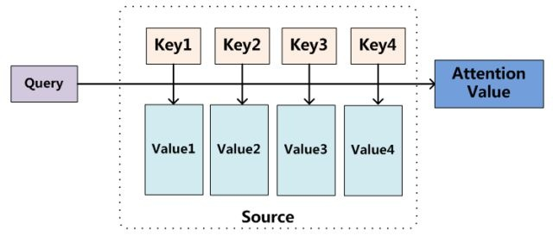
Bert-Attention

Slide 18
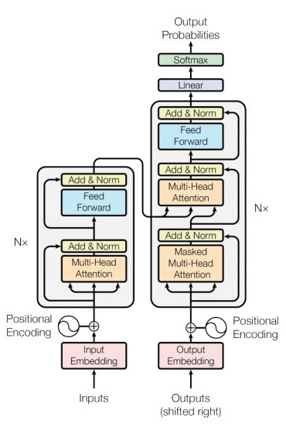
Bert-Transformer

Slide 19
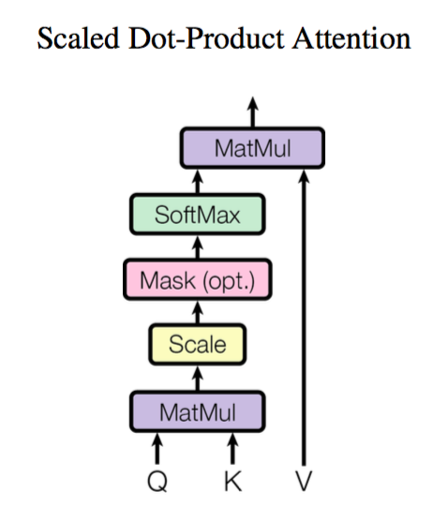
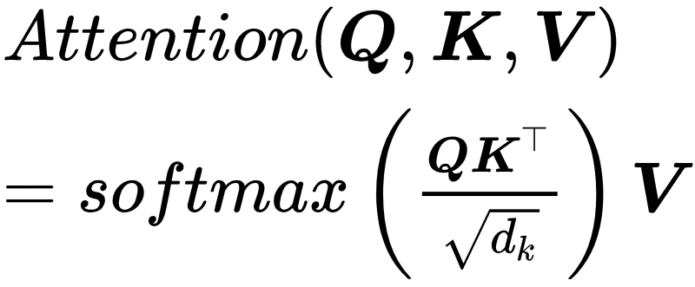
Bert-Transformer
https://kexue.fm/archives/4765

Slide 20
Outline
Problem
Gender Bias
Dataset
BERT
Evaluation

Slide 21
Evaluation
Multi-class logarithmic loss
where N is the number of samples in the test set, M is 3, log is the natural logarithm, yij is 1 if observation i belongs to class j and 0 otherwise, and pij is the predicted probability that observation i belongs to class j.

Slide 22
Evaluation
TP: true positive FN: false negative
FP: false positive TN: true negative
Ground Truth | Prediction
 | Positive | Negative
Positive | TP | FN
Negative | FP | TN

Slide 23
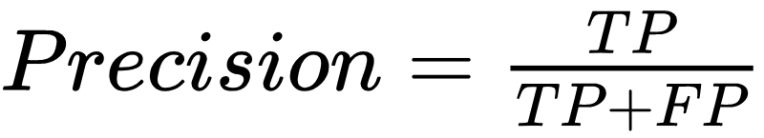
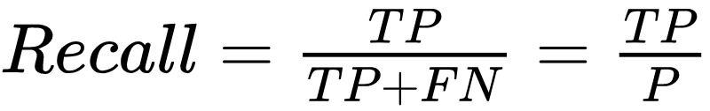

Evaluation
Precision
Recall
F1 score

Slide 24
Evaluation
F1 score
Get bias by compare F1 scores by gender (female/male)

Slide 25
References
Soon, Wee Meng, Hwee Tou Ng, and Daniel Chung Yong Lim. "A machine learning approach to coreference resolution of noun phrases." Computational linguistics 27.4 (2001): 521-544.
Vaswani, Ashish, et al. "Attention is all you need." Advances in neural information processing systems. 2017.
Devlin, Jacob, et al. "Bert: Pre-training of deep bidirectional transformers for language understanding." arXiv preprint arXiv:1810.04805 (2018).

